Slide 1


BAN210- Final Assessment
Krystel Venice Lanzaderas Student No. 106889215

Slide 2


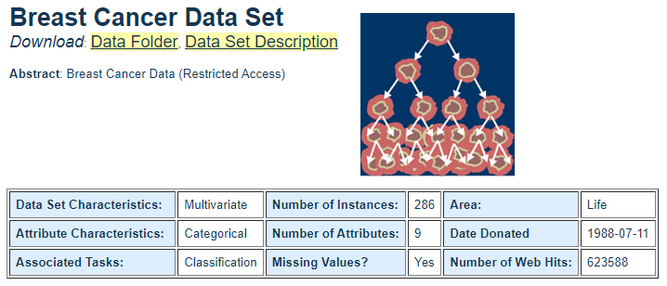

Predictive Analytics models
Breast Cancer Data This is one of three domains provided by the Oncology Institute that has repeatedly appeared in the machine learning literature. This data set includes 201 instances of one class and 85 instances of another class. The instances are described by 9 attributes, some of which are numeric, and some are nominal.

Slide 3
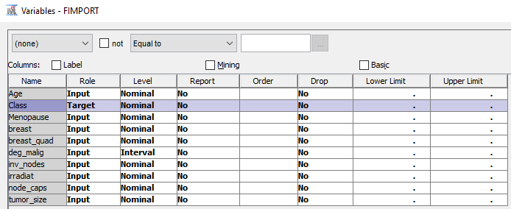
SELECTING TARGET VARIABLE
Choose Class as the Target

Slide 4
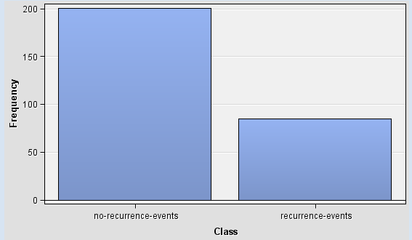
frequency plot of Class

Slide 5
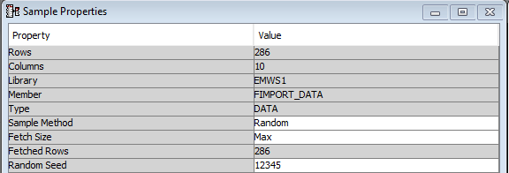
There are 285 rows and 10 Columns imported

Slide 6
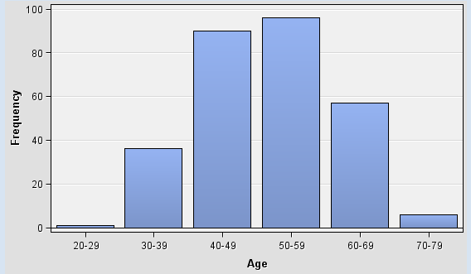
Age is suitable for linear regression as it shows a U-shaped curve.

Slide 7
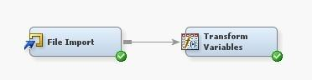
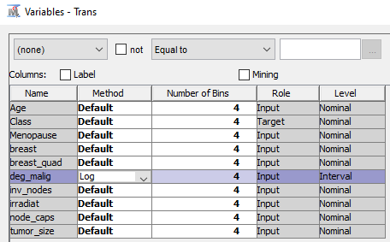
In Transform node, choose breast_quad variable for Log method since all of the variables are Nominal.

Slide 8

The formula selected is log(deg_malig +1)

Slide 9
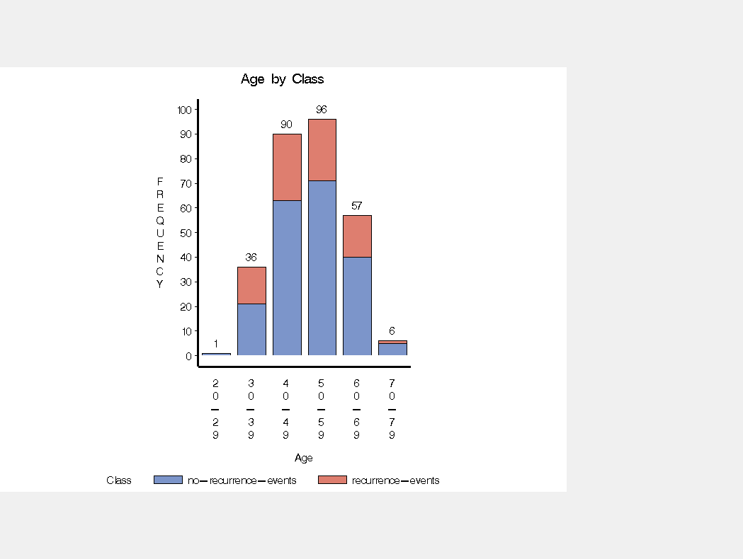
In the MultiPlot node, choose BAR CHART plot as the Type of Charts.

Slide 10
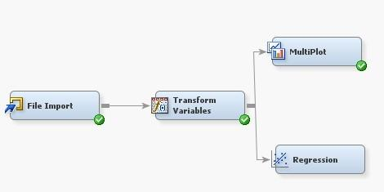
REGRESSION MODEL

Slide 11
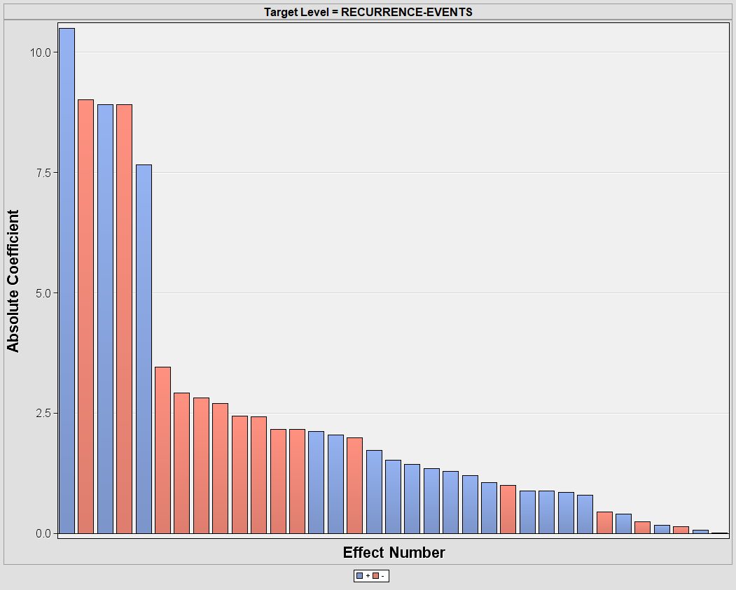
no-recurrence-events have the highest number of coefficients.

Slide 12
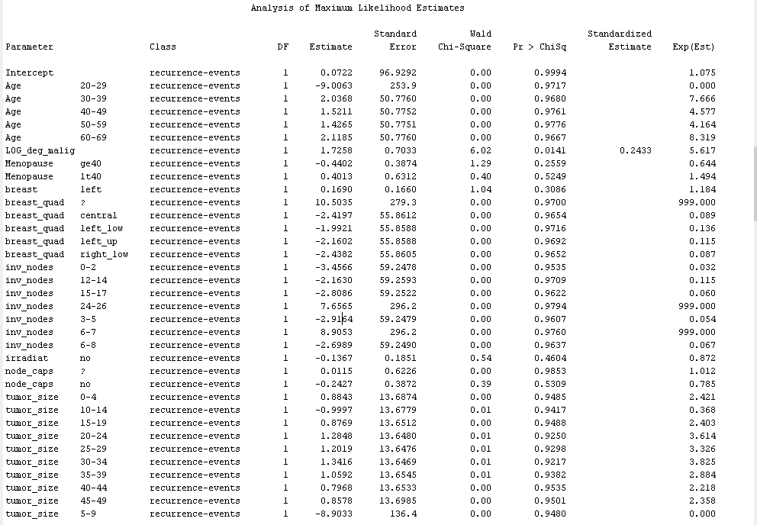
Based on this model, the predicted standardized for _deg_malig is 0.2433 most of the Class target has recurrence-events.

Slide 13
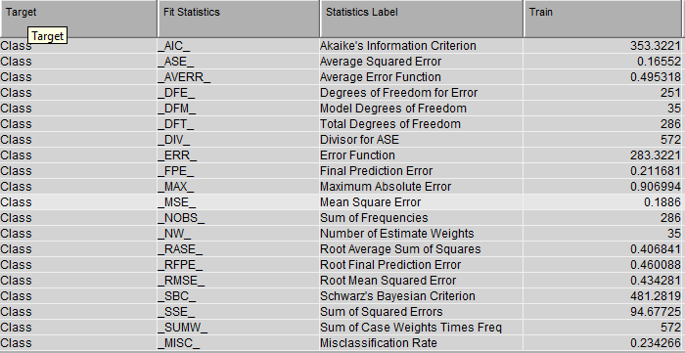
Mean Square Error (MSE) for the target Class is 0.1886

Slide 14
THANK YOU! ☺

